Slide 1
Growth responses of a green alga to multiple environmental drivers
Georgina Brennan & Sinéad Collins
In Nature Climate Change 5:892-897

Slide 2
The study
Chlamydomonas reinhardtii

Slide 3
The study
Chlamydomonas reinhardtii
response variable:
growth rate

Slide 4
The study
Chlamydomonas reinhardtii
response variable:
growth rate
8 environmental drivers
96 treatments

Slide 5
x 3 replicates

Slide 6
The question
→ Can we predict the growth rate when multiple environmental drivers occur?
From Côté, Darling and Brown (2016) Proc. R. Soc. B. 283: 20152592

Slide 7
The goal of the reproduction
Interest of multiple environmental drivers
Learn more about Generalized Mixed Models
here, GAM: Generalized Additive Model
Compare models and results with my project

Slide 8
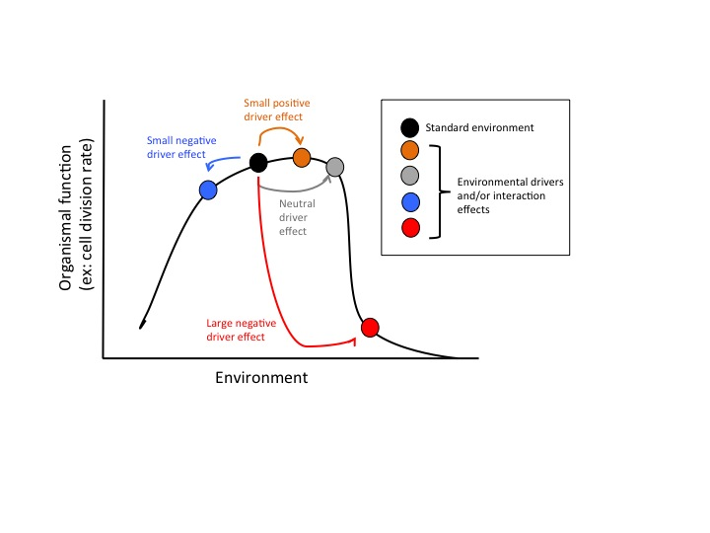
Fig.1 Cartoon of the effects of multiple drivers on organismal function using environmental tolerance curve
→ Will not be reproduced

Slide 9
Fig.2 Population growth rate of C. reinhardtii under zero to eight environmental drivers
→ Will be reproduced

Slide 10
Fig.2a Population growth rate of C. reinhardtii under zero to eight environmental drivers

Slide 11
Fig.2b-d Population growth rate predicted by a model (triangles) versus observed (points)
Comparative model
(aka dominance model)
Multiplicative model
Additive model

Slide 12
Fig.3 Population growth rate of C. reinhardtii in test environments containing high CO₂, low pH and high temperature
→ Will be reproduced

Slide 13
Others figures from SI
Fig S1. Population extinction risks of C. reinhardtii at different numbers of environmental drivers

Slide 14
Others figures from SI
Fig S3. Effect of sampling from a finite number of environments

Slide 15
Others figures from SI
Fig S6. Population growth curves of C. reinhardtii under 0 to 8 environmental drivers.

Slide 16
The reproduction
file:///Users/garnier/Dropbox/PHD/GitHub/RREEBES/Brennan_Collins_2015_Nat-Clim_change/report.html

